Slide 1
Dogs of Zuerich
Springboard storytelling exercise
Martin Wipf

Slide 2
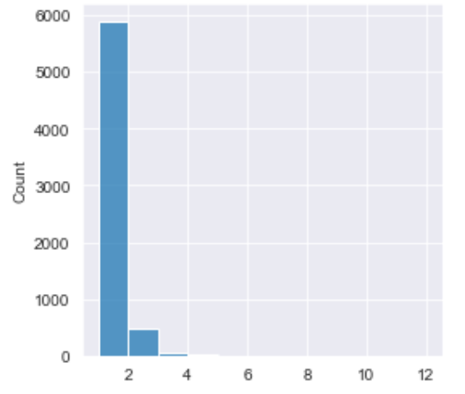
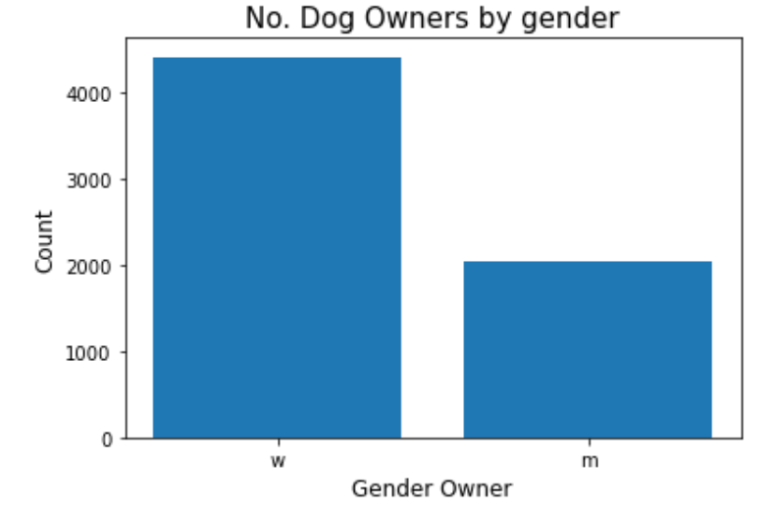
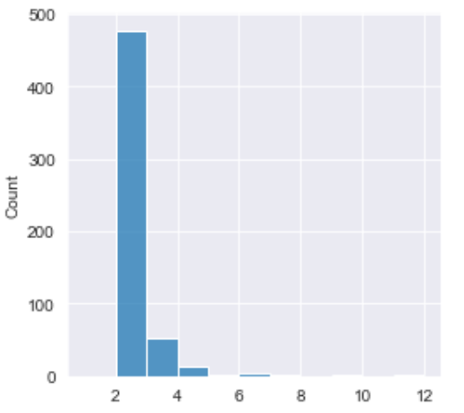
Who are the dog owners?
5895 owners have 1 dog
n=6446 owners
4412 woman
551 owners have
Multiple dogs
2034 man
Notes:
There’s a total of 6446 dog owners. Of these 5895 own a single dog and 551 have at least 2 dogs. 52 people own 3 and 14 own 4 dogs. The maximum is 11 dogs.

Slide 3
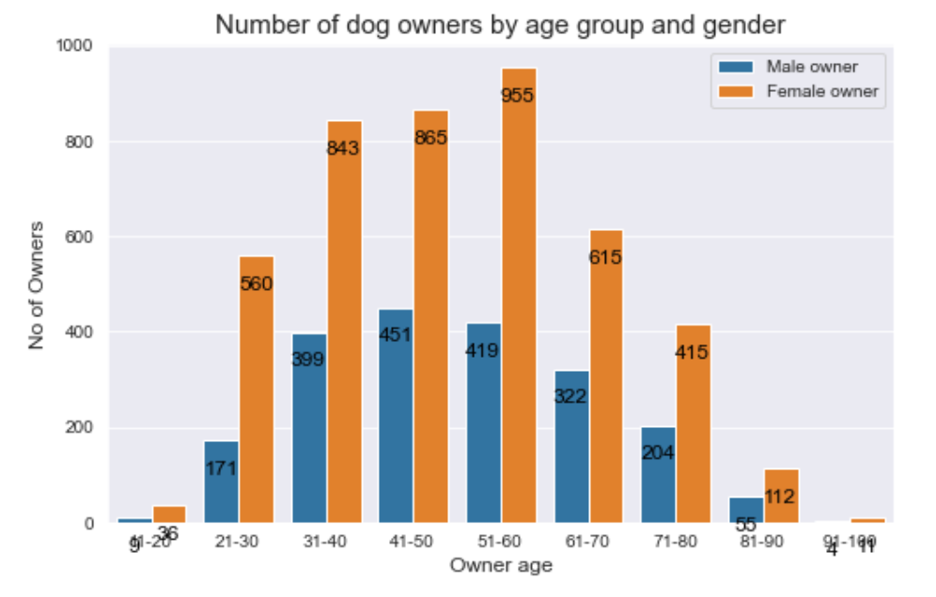
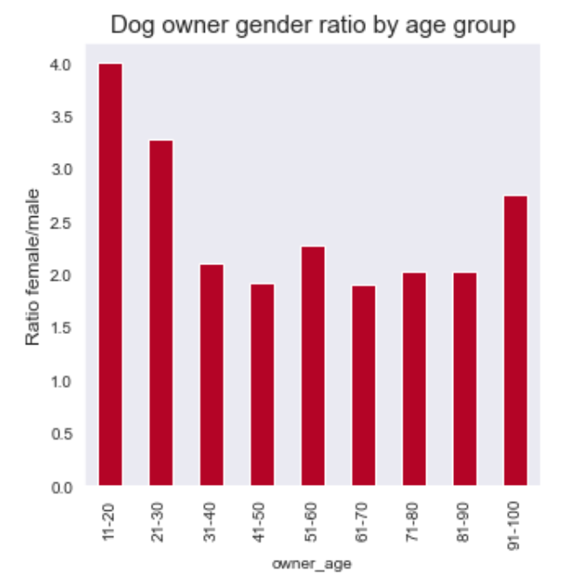
Owner age and gender
Notes:
On average there’s about twice as many female than male dog owners. However there’s is some variation to this ratio across different age groups but there’s more female dog owners in every age group. Especially the younger age groups (11-20 and 21-30) and the oldest age group (91-100) have a higher number of female owners.

Slide 4
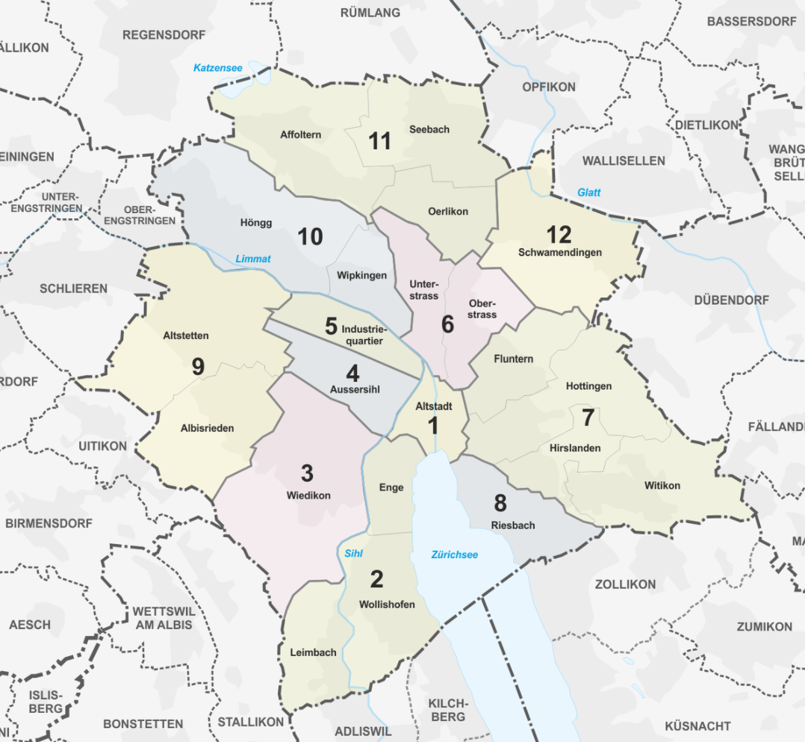
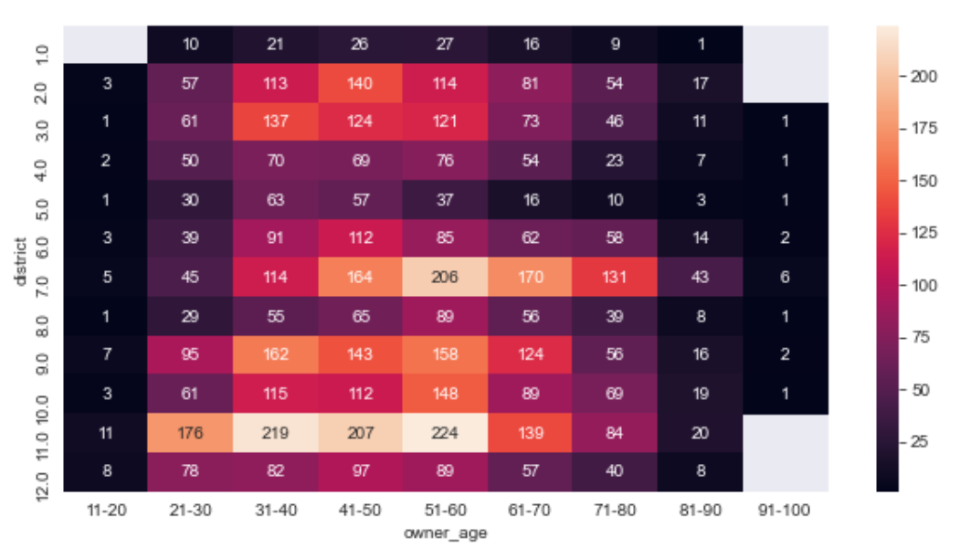
Where do they live?
Notes:
In general the two age groups 41-50 and 51-60 own the most dogs in every district of the city. The absolute number of dogs depends on the district. Unsurprisingly the more central districts (1, 4, 5, 8) have lower numbers while districts (7, 9, 11) located on the outskirts of the city have higher numbers.

Slide 5
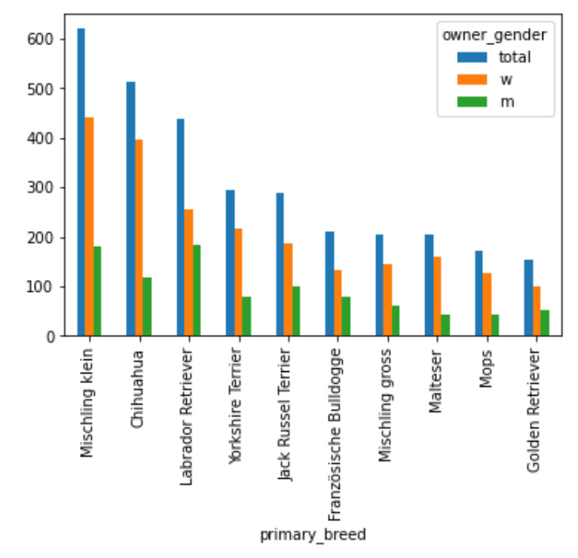
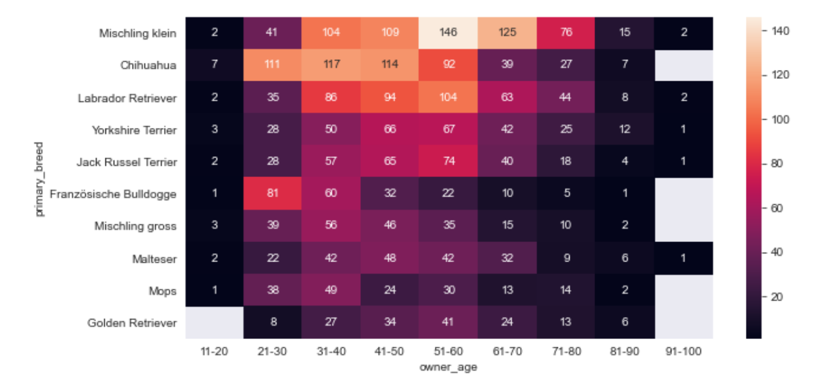
Most popular dog breeds by age
Notes:
Mischling klein (small muds) are most popular with age groups 51-80 while Chihuahuas are most popular with age groups 21-50. Otherwisel age does not play a major role in which breeds are most popular. For the very young age group (11-20) and the older age groups (71-100) the number of dogs are low and a statistically relevant interpretation is difficult. There does seem to be a gender related difference in the most popular breeds.

Slide 6
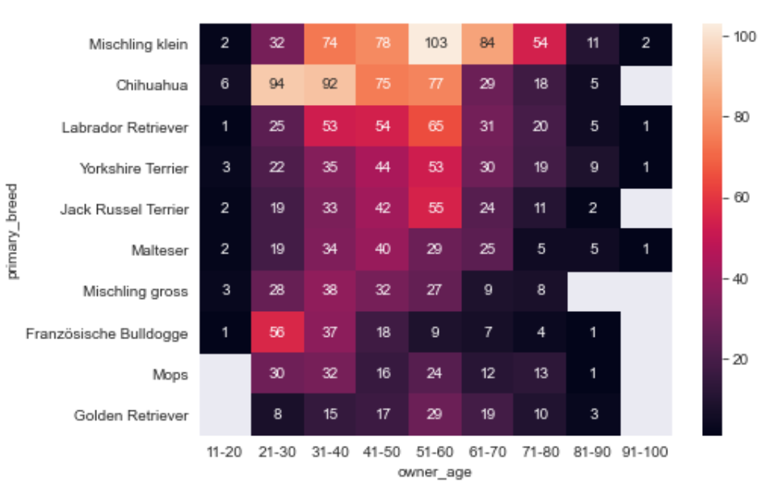
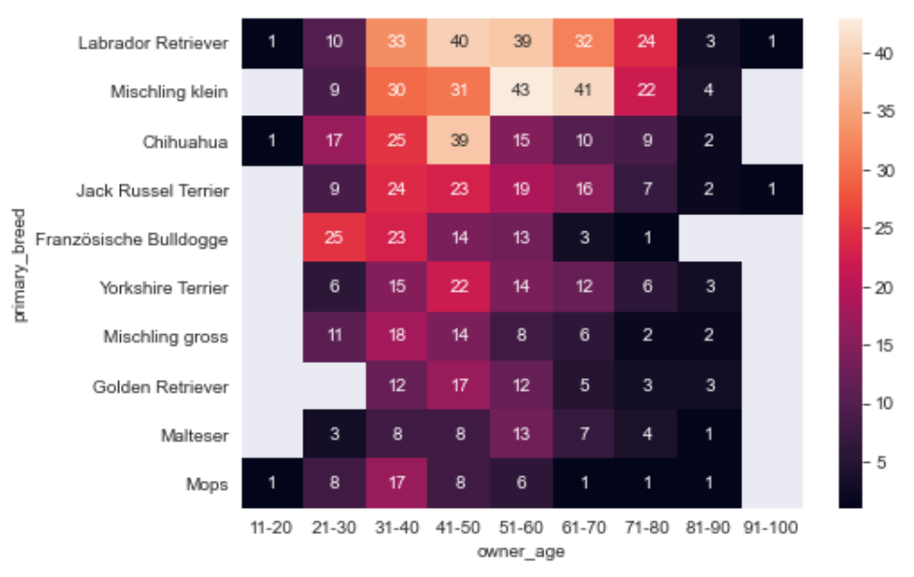
Most popular dog breeds, differences by gender
Womens preferred breeds by age
Mens preferred breeds by age
Notes:
As seen in the previous slide there’s some differences in preferred dog breeds due to the owners gender. The most popular 10 breeds are identical but in different order. Additionally the top 3 breeds are the same for men and women but again in different order.

Slide 7
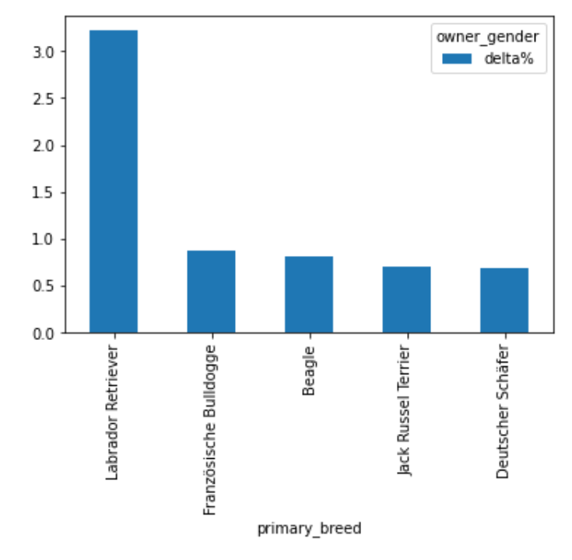
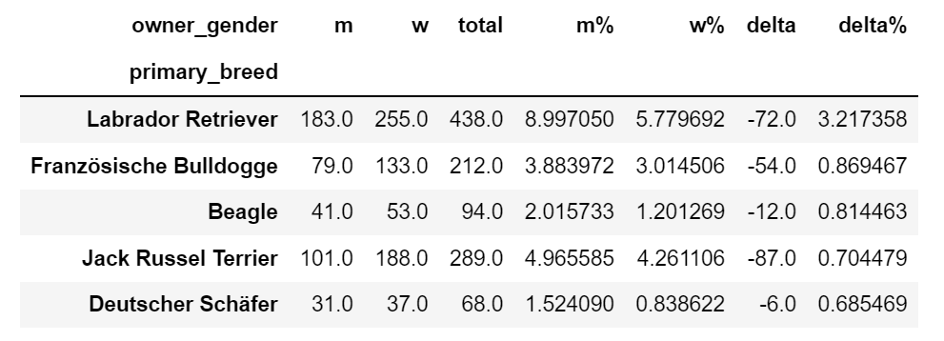
Biggest differences between men and women
% difference between breeds
Notes:
This plot shows the 5 biggest differences in breeds between men and women. Roughly 9% of all dogs owned by men are Labrador Retrievers while only 5.8% of women own Labrador Retrievers. For other breeds the difference seems smaller (<1%). While not exclusively the case men prefer bigger dogs.

Slide 8
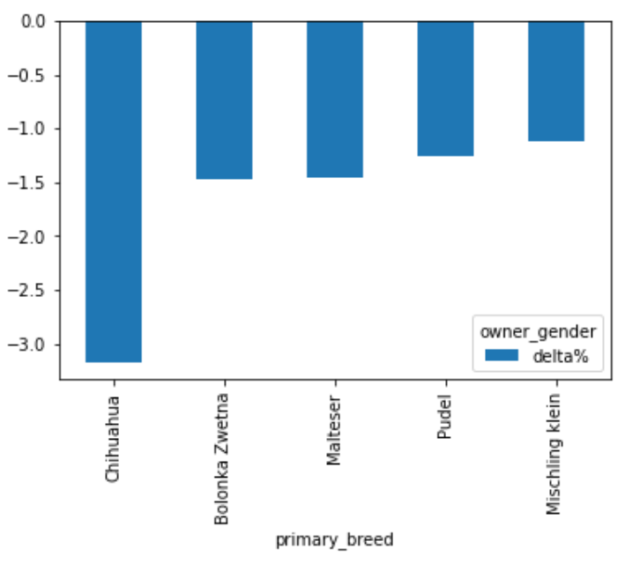
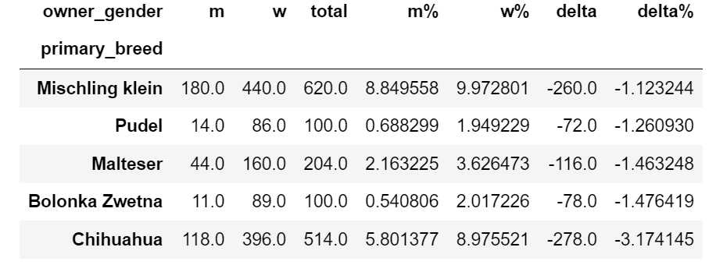
Biggest differences between women and men
% difference between breeds
Notes:
There is a similar difference between certain breeds popular with women but the difference tends to be a bit higher than for breeds popular with men. While ~9% of women own Chihuahuas only ~6% of men own the same breed. All of these 5 breeds are relatively small dogs.

Slide 9
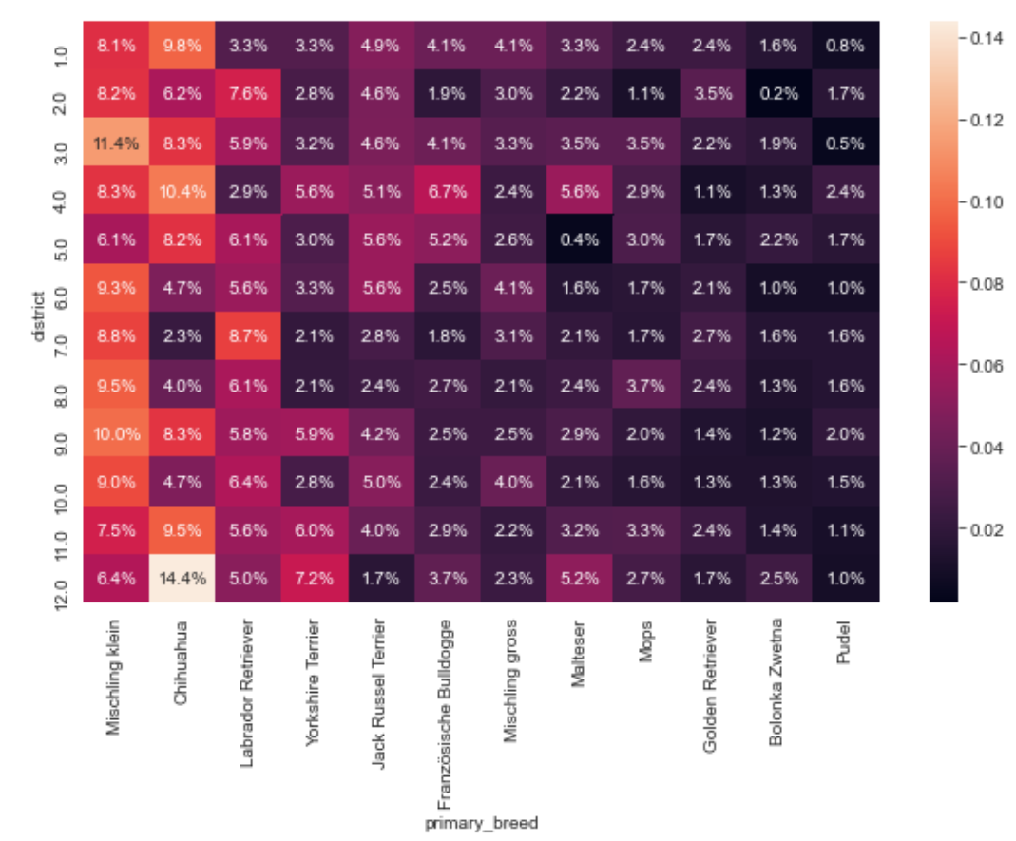
Most popular dog breeds by district
Notes:
This slide shows the differences of popular breeds by district in % of all dogs within one district. For example 14.4% of all dogs in district 12 are Chihuahuas While there are slight variations there does not seem to be a huge variation of preferred breeds across the different districts..

Slide 10
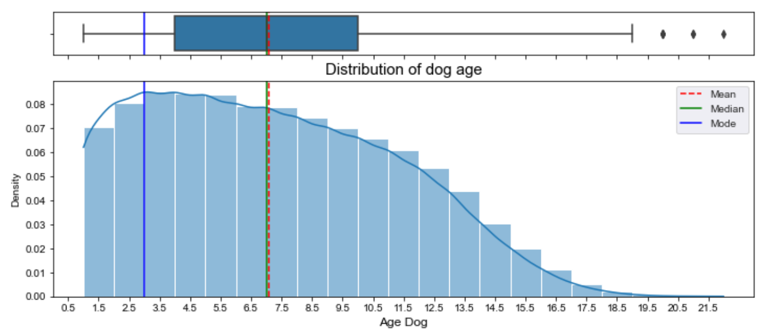
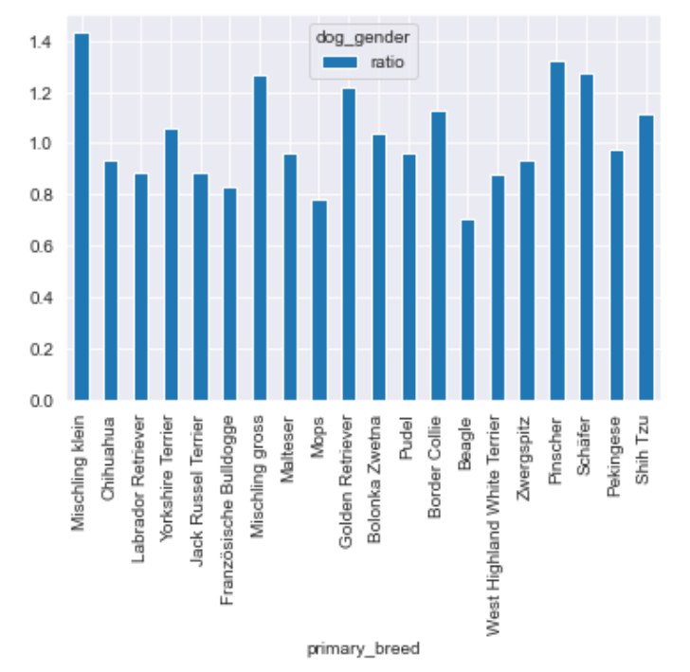
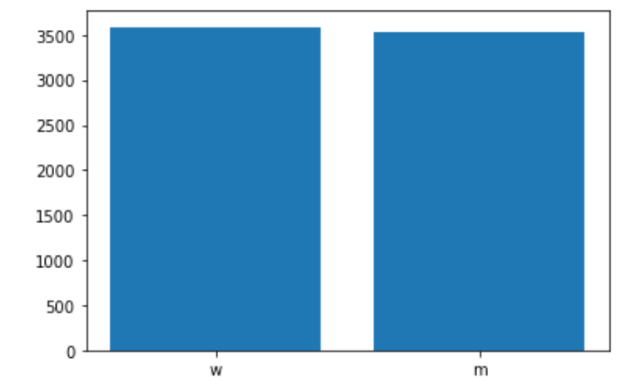
Age of dogs
n= 7122 dogs
3588 female dogs
3524 male dogs
Notes:
The average age of the dogs is ~7 years. The oldest dogs are ~20-21 years old. As expected there's fewer and fewer dogs with increasing age. In general there's very little difference between the number of male and female dogs. A few breeds have more males and others have more females but all summed up the difference is remarkably small.

Slide 11
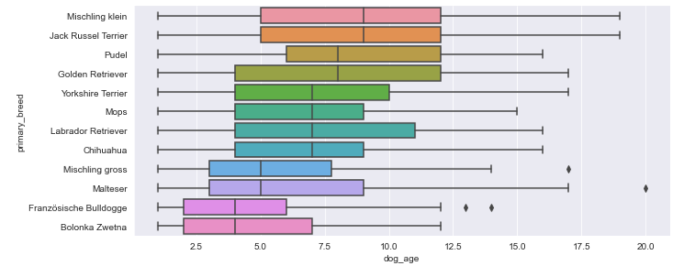
Age of most popular breeds
Notes:
This is more in depth look at the age of the top 10 breeds. The distribution for the breeds overlap to a large part but there seems to be a breed dependent maximum age.

Slide 12
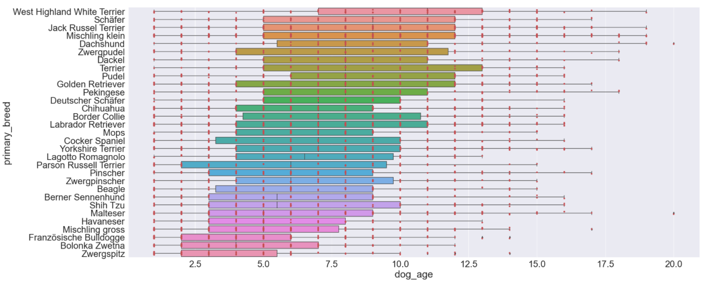
Age of breeds with n>50
Notes:
Same plot but for all breeds with more than 50 dogs, in order to get a statistically relevant number. While there's still an overlap of the different breeds it become clear that there is a breed dependent maximum age.

Slide 13
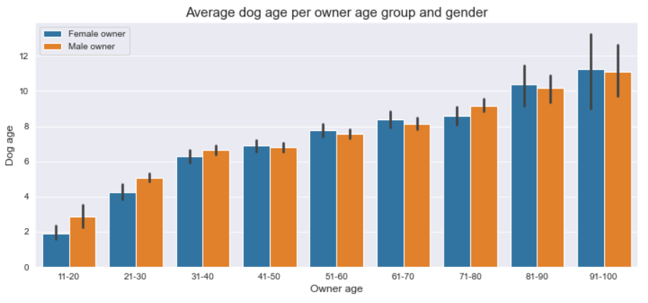
Average dog age by owner age group
Notes:
Younger dog owners tend to have younger dogs while older age group tend to have older dogs. This is most pronounced in the age groups of 11-30 and 81-100.

Slide 14
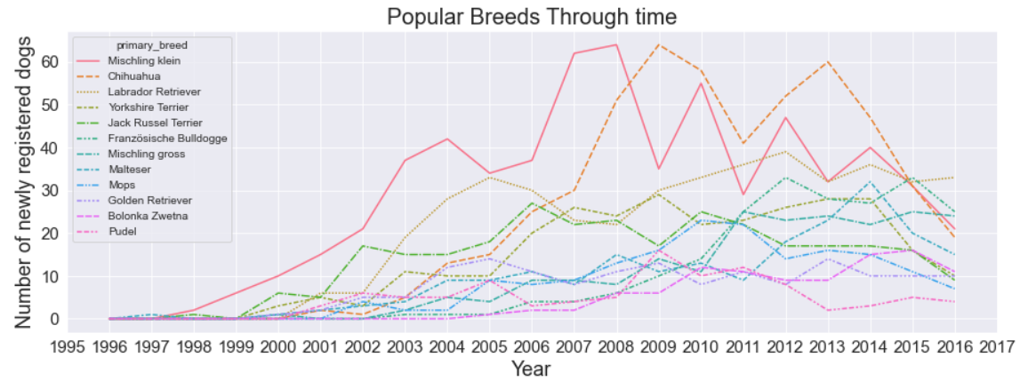
Popularity of breeds through time
Notes:
Popularity of certain breeds have fluctuated somewhat over time. The data looks fairly noisy but especially Chihuahuas have increased from 2006-2009 and seem to decrease again since 2013. Misscling klein have increased in popularity from 1999-2008 and also seem to decrease since reaching a peak at 2008. There's a slight continuous increase of Labrador Retriever since 2002. Other breeds to not show significant variations across time.

